Slide 1
Broadcasting and Disasters
Impact of Images that might change the course of History
Toshiyuki Sato (NHK-Japan)

Slide 2
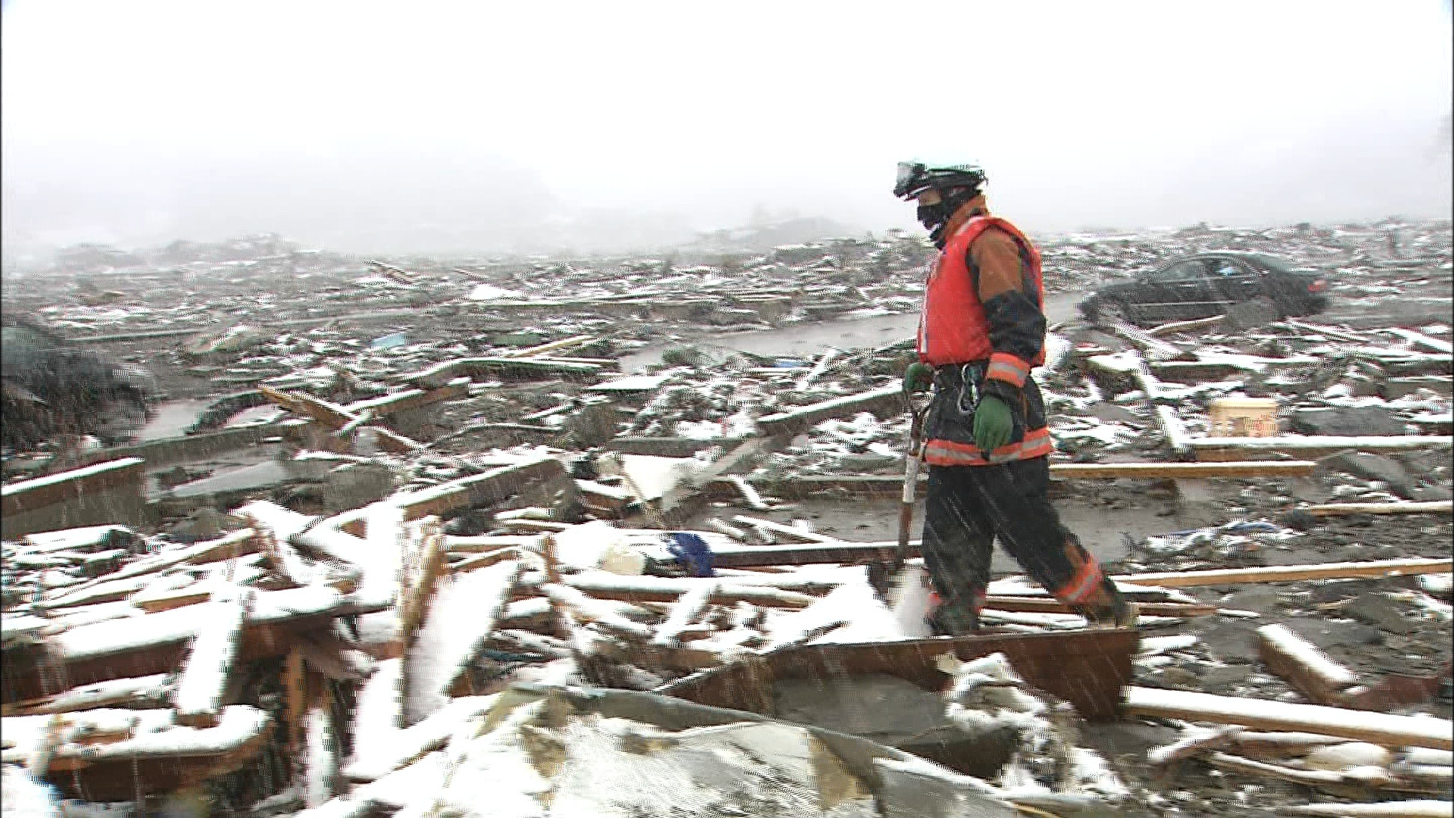
Great East Japan Earthquake March 11,2011
M.9.0
24,000 Dead and Missing
92% of the dead are by Tsunami

Slide 3
Sendai (April)

Slide 4
Fukushima Nuclear Power Plant

Slide 5
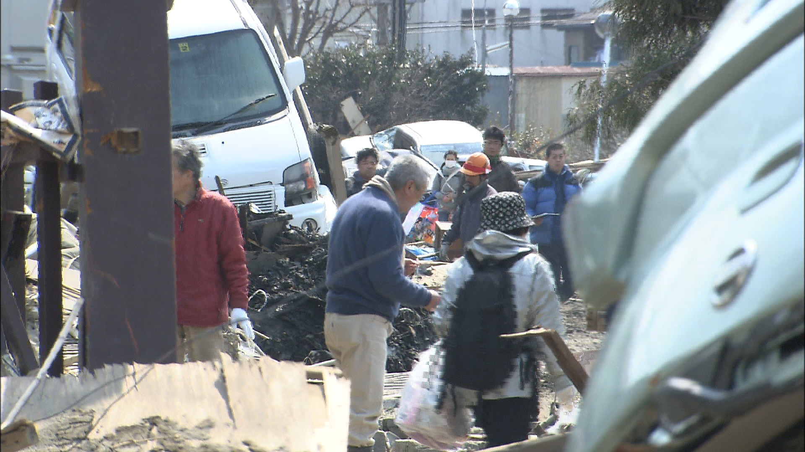
After the Tsunami left

Slide 6
Safe are Japanese food…

Slide 8
rrr
March 11th 13:00-21:00 From Video Research
Red line is NHK.
14：46 NHK starts broadcast
14：46: NHK starts broadcasts.
Notes:
Japan is prone to natural disasters, so NHK has always positioned disaster response as one of our main pillars. We play a unique, legally mandated role in delivering disaster information to the public so as to help save lives and property. And the public expects us to deliver that information.
This chart shows our ratings. As you can see, a huge number of people tuned in to NHK after the earthquake.
Now, I’d like to show you a short clip of what NHK aired.
これまでも多くの地震と津波を経験してきた日本の公共放送として、ＮＨＫは国民の生命と財産を守るという使命がある。また災害対策基本法でもＮＨＫは国の唯一の指定報道機関とされている。的確で正確な情報をなるべく早く放送することが基本原則。
視聴者もそれをNHKに期待している。
これは、地震発生後の視聴率のチャートだが、NHKに人々はチャンネルを合わせたことが分かっていただけると思う。
では、ここで、NHKが何を放送したか、その映像をまとめたVTRをご覧ください。

Slide 9
Which agency people turn to at emergency？ （Nomura Institute, March 19,20)
NHK TV 80.5％
Commercial TV 56.9
Portal Site 43.2
News Papers 36.3
…
7) Social Networking Service 8.3

Slide 10
Earthquake Early Warning System
Earthquake Early Warning (JMA)
Warning for strong tremors
Map
Prefecture or area
Notes:
080826スリランカ研修
10

Slide 11
Earthquake Early Warning System
seismograph
P-wave
JMA
S-wave
Epicenter
High-performance seismograph
detects the P-wave
“Epicenter” “Magnitude” and
“Seismic intensity” of the surrounding area are estimated within seconds
“possible strong tremors”
before S-wave reaches surrounding area

Slide 12
Two Waves of Quakes
Primary-Wave
Secondary-Wave
8 km/Sec
Travels fast but not hazardous
4 km/Sec
Major Wave and
can be hazardous

Slide 13
How waves travel. (If you are 80Km away from epicenter…)
Epicenter You are here
P-Wave reaches in 10 sec..

Slide 14
How quake waves travel. (If you are 80Km away from epicenter…)
Epicenter You are here
P-Wave reaches in 10 sec..
S-Wave 20 Sec. to reach

Slide 15
If Seismographs are located close to epicenter, …
Epicenter You are here
If judged P-wave is strong,
warning through TV and radio is made;
” big earthquake will
come immediately!!!!”
You will have closely to 20 seconds to prepare.

Slide 16
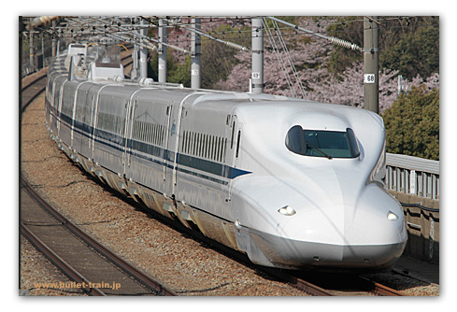
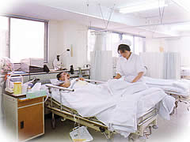
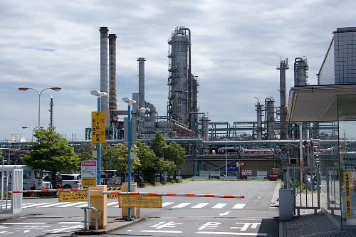
It is also linked to…

Slide 17
Earthquake Early Warning System (for the public)
seismograph
P-wave
JMA
Technical issues
▼ Possible error in seismic intensity estimation
▼ It may be too late for the area close to the epicenter
S-wave
Epicenter
High-performance seismograph
detects the P-wave
“Epicenter” “Magnitude” and
“Seismic intensity” of the surrounding area are estimated within seconds
“possible strong tremors”
before S-wave reaches surrounding area

Slide 18
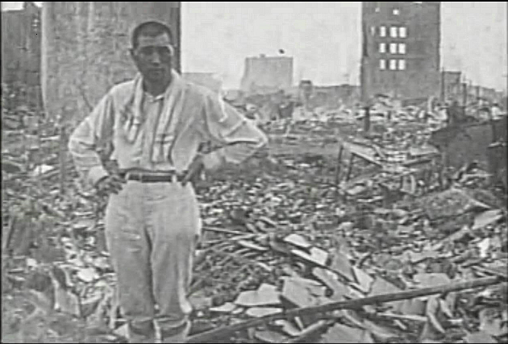
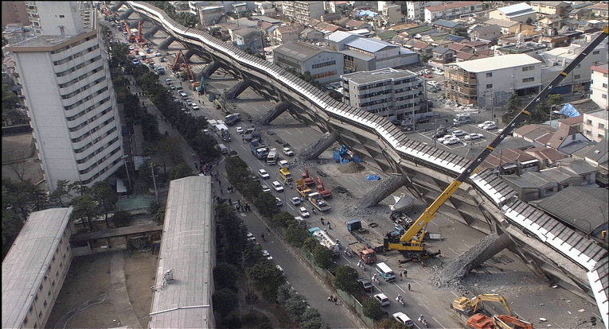
Great Earthquakes in Japan
The Kanto Earthquake(1923) The Kobe Earthquake(1995)
More than 14 thousand killed 6,400killed
Notes:
A feature of High Definition TV (HDTV)
has a wide range of possible applications,
including not only broadcasting, DVD and movie production, but also art galleries, medicine,
printing and the preservation of cultural assets.
Our government is promoting studies on digital TV
as the hub of a home network connecting various home information appliances
and as a terminal to retrieve information
provided by municipalities.
In line with government policy,
we would like to develop TV into an integrated information terminal（Integrated Service TV). TV as an integrated information terminal
must be at least 40-inch widescreen and HD, because TV is operated using a remote controller from a distance of several meters,
and has to show letters and still images
in minute detail.

Slide 19
NHK World TV also responded…
2:46 p.m. Quake took place
Prepared English graphics, loading live feeds
from domestic channel, anchor person…
2:57 p.m. Started live international broadcasting
for almost three hours non-stop.

Slide 20
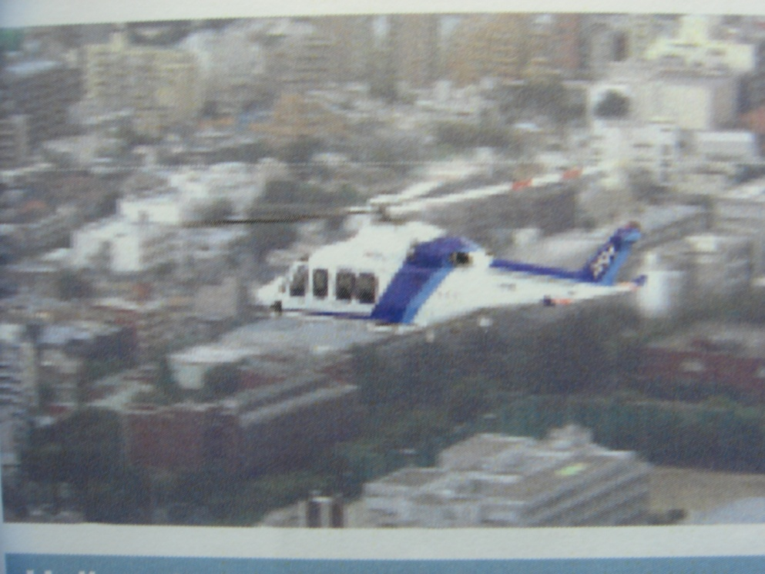

Slide 21
Washington Post March 28

Slide 22
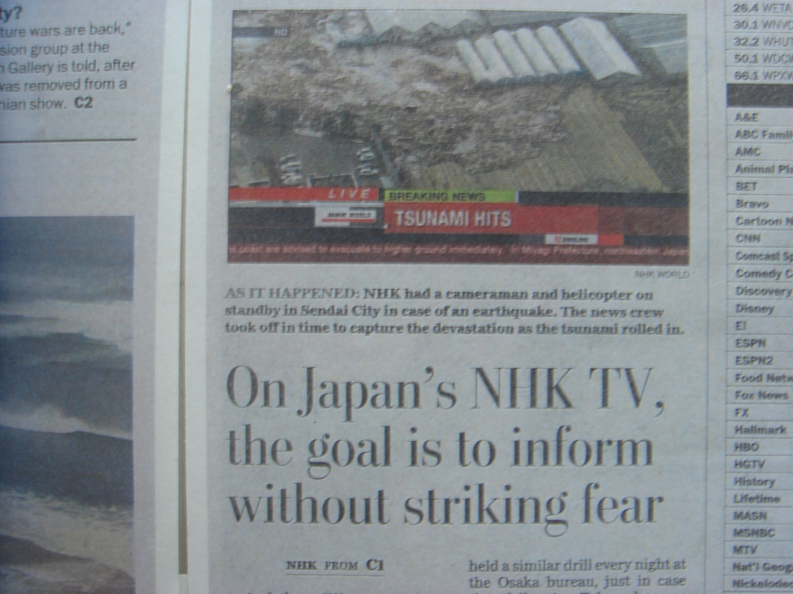

Slide 23
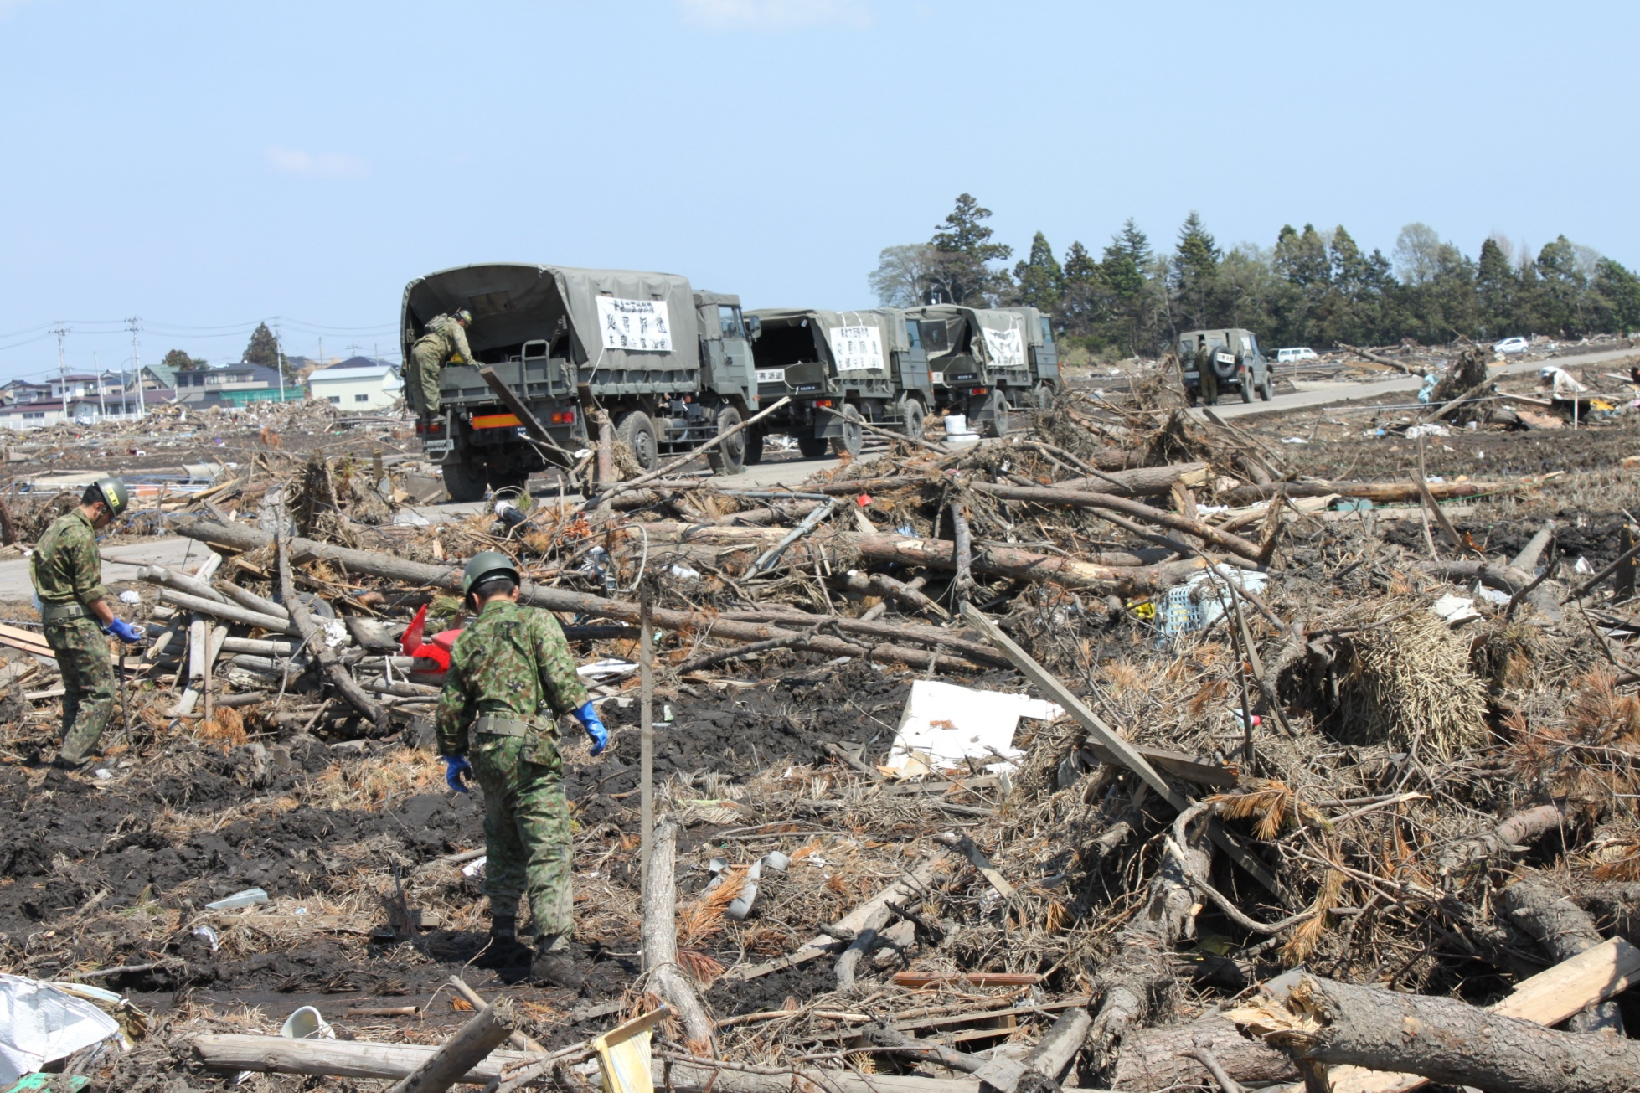

Slide 25
Recent Major Earthquakes
Magnitude Dead/Missing
‘04 Dec. Indian Ocean 9.0 220,000
‘08 May Wenchuan/China 8.0 87,000
‘10 Jan. Haiti 7.1 220,000
‘11 Feb. New Zealand 6.1 240
‘11 Mar. East Japan 9.0 25,000

Slide 26
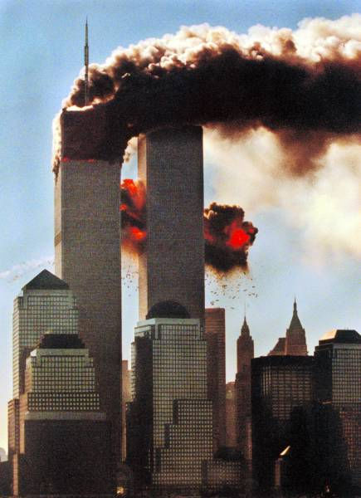
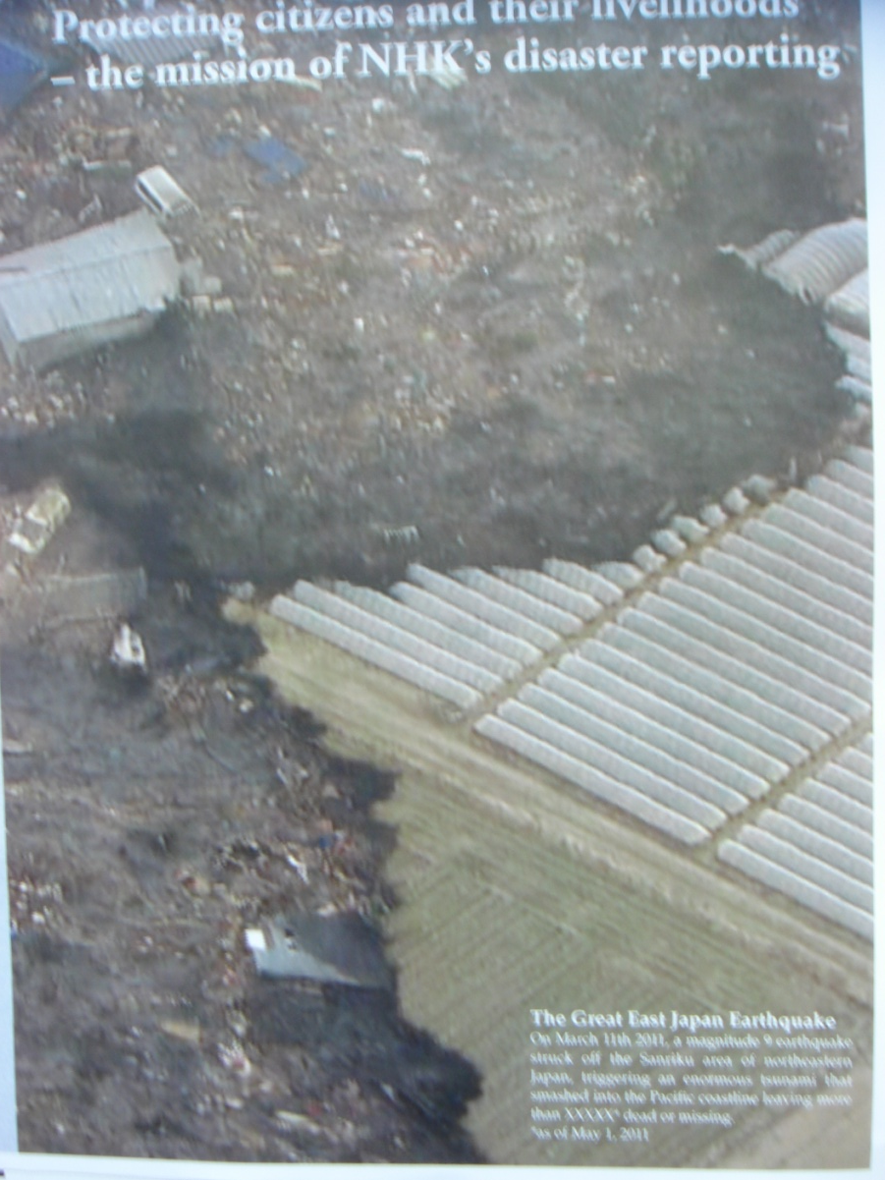
911 / 311 How live images can impact audience

Slide 27
9 11
Fear Hatred
War against Terror
(Afghan, Iraq)
3 11
Power of nature
Fate
Sympathy, beyond boarder
(Sense of Global Community)

Slide 28
Preparedness for broadcasters
Earthquake tsunami
torrential rain (floods, landslide) typhoons
volcanic eruptions
glacial lakes …
Terrorism
accidents
Social uprising
(ex. Jasmine revolution)

Slide 29
Broadcasting and Disasters
Impact of Images that might change the course of History
Toshiyuki Sato (NHK-Japan)

